Slide 1

DEPARTMENT OF ARTIFICIAL INTELLIGENCE AND DATA SCIENCE ACADEMIC YEAR 2025 - 2026 SEMESTER III ARTIFICIAL INTELLIGENCE LABORATORY MINI PROJECT REVIEW <ROCK PAPER SCISSOR AI AGENT>
REGISTER NUMBER | 2117240070335
NAME | VAISHNAVI C
YEAR | ||
SECTION | F
FACULTY IN-CHARGE | Mrs. M. Divya

Slide 2
PROBLEM STATEMENT
Artificial Intelligence (AI) is a branch of computer science that focuses on creating machines capable of performing tasks that normally require human intelligence
In the gaming domain, AI helps create more engaging and challenging experiences by allowing computer opponents to learn and react intelligently to players’ actions. This project applies AI techniques to a simple yet strategic game — Rock–Paper–Scissors — to demonstrate how machines can learn from patterns and make decisions that resemble human reasoning.
Developing an AI for a simple game like Rock–Paper–Scissors provides a foundational understanding of machine learning concepts, predictive modeling, and game theory. It demonstrates how AI can evolve from random responses to strategic thinking, which is a key principle in developing intelligent systems for more complex applications.

Slide 3
THEORETICAL BACKGROUND
Theoretical Background
Artificial Intelligence (AI) enables machines to mimic human intelligence through learning, reasoning, and problem-solving. In this project, AI is applied to make the computer an intelligent opponent in the Rock–Paper–Scissors game.
The theoretical foundation lies in pattern recognition and predictive modeling. Instead of relying purely on random outputs, the AI observes a player’s past moves to identify possible behavioral patterns. Using probability-based predictions or learning models, the AI determines the most likely next move of the player and selects the counter-move that can win against it.
The approach is rooted in machine learning, specifically supervised learning or Markov models, where the system learns transition probabilities between different states (Rock, Paper, or Scissors). Even without complex datasets, a lightweight predictive algorithm can approximate human tendencies and respond intelligently.

Slide 4
THEORETICAL BACKGROUND
Justification for Choosing the Algorithm
For this project, a Pattern Recognition using Frequency/Probability Model is chosen.
Reasons for selection:
Simplicity and Efficiency – It requires minimal computation and is ideal for real-time gameplay.
Data Suitability – The game produces small datasets (few past moves), making complex models unnecessary.
Interpretability – The logic behind predictions is transparent and easy to explain, aligning with educational objectives.
Performance – Probability-based models adapt quickly to recurring patterns in player behavior, achieving higher accuracy over time compared to random guessing.
Thus, the frequency-based prediction model provides a good balance between accuracy, speed, and understandability.

Slide 5
IMPLEMENTATION AND CODE
Link to code in Git-hub Repository
List | Git-hub Repository Links
Implementation of Code Link | Rock--paper-scissor/Rock-Paper-scissor.py at main · crvaishnavivaishnavi-dotcom/Rock--paper-scissor
Word Document Report Link | Rock_Paper_Scissor_AI_Mini_Project_Report.docx
PPT Link | AILAB_MINI_PPT_TEMPLATE_AI^0DS.pptx

Slide 6
CODE
import random
def get_user_choice():
choices = ['rock', 'paper', 'scissors']
user_input = input("Enter rock, paper, or scissors: ").lower()
while user_input not in choices:
print("Invalid input.")
user_input = input("Enter rock, paper, or scissors: ").lower()
return user_input
def get_computer_choice():
choices = ['rock', 'paper', 'scissors']
return random.choice(choices)
def determine_winner(user, computer):
if user == computer:
return "It's a tie!"
elif (user == 'rock' and computer == 'scissors') or \
(user == 'scissors' and computer == 'paper') or \
(user == 'paper' and computer == 'rock'):
return "You win!"
else:
return "Computer wins!"

Slide 7
CODE
def main():
print("Welcome to Rock, Paper, Scissors!")
user_choice = get_user_choice()
computer_choice = get_computer_choice()
print(f"You chose: {user_choice}")
print(f"Computer chose: {computer_choice}")
result = determine_winner(user_choice, computer_choice)
print(result)
if __name__ == "__main__":
main()

Slide 8
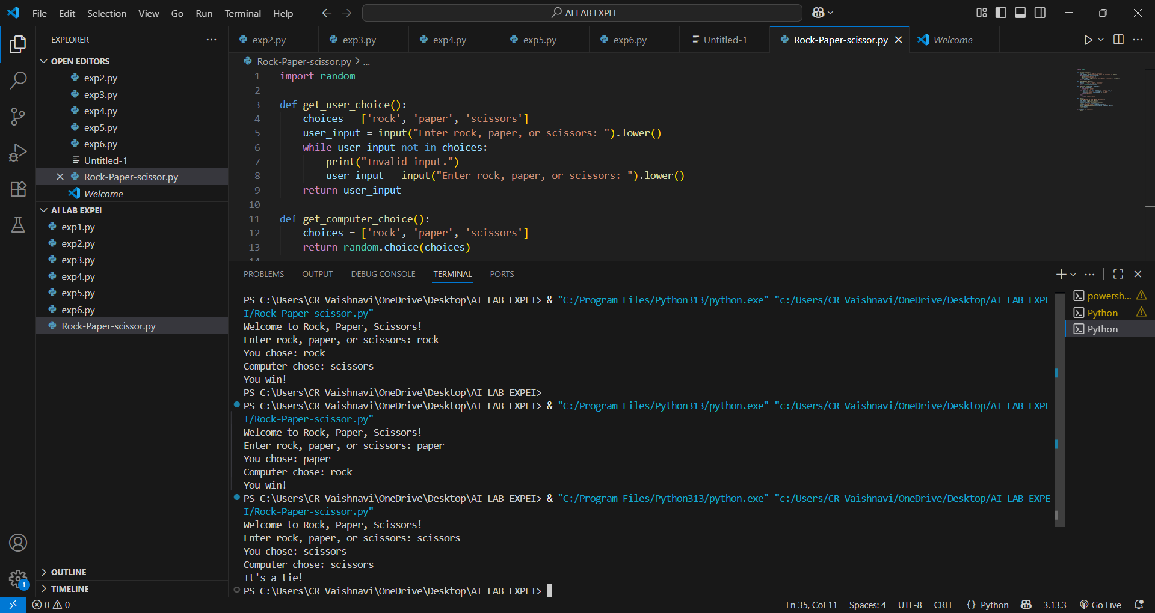
OUTPUT AND RESULTS

Slide 9
REFERENCES
1. Multi‑AI competing and winning against humans in iterated Rock‑Paper‑Scissors game — Lei Wang et al. (2020) Link: https://arxiv.org/abs/2003.06769
2. Human Randomness in the Rock‑Paper‑Scissors Game — MDPI Applied Sciences (2022) Link: https://www.mdpi.com/2076-3417/12/23/12192
3. Rock‑Paper‑Scissors AI (GitHub repo) — dmickelson / GitHub Link: https://github.com/dmickelson/Rock-paper-scissors

